Slide 1

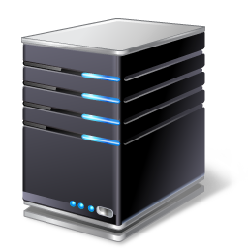
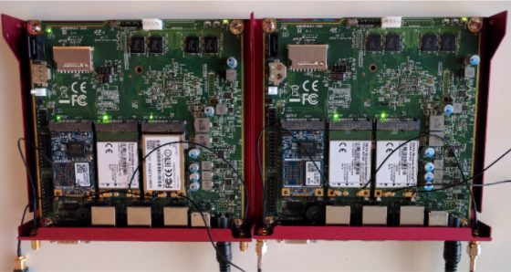
downlink
MONROE node
Telenor
Amazon VM
Internet
ASTREAM Client
ASTREAM Server
Telia
uplink
ICE

Slide 2

MONROE node
Telenor
Amazon VM
Internet
ASTREAM Client
ASTREAM Server
Telia
ICE

Slide 3

MONROE node
Telenor
Amazon VM
Internet
ASTREAM Client
ASTREAM Server
Telia
ICE

Slide 4
MONROE node
Telenor
Amazon VM
Internet
ASTREAM Client
ASTREAM Server
Telia
Basic SARA BBA
ICE

Slide 5
MONROE node
Telenor
Amazon VM
Internet
ASTREAM Client
Telia
ASTREAM Server
Basic SARA BBA
ICE

Slide 6
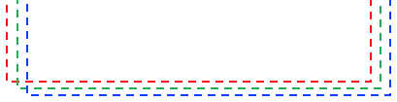
MONROE node
Amazon VM
Telenor
Internet
ASTREAM Client
Telia
ASTREAM Server
ICE
Basic SARA BBA

Slide 10
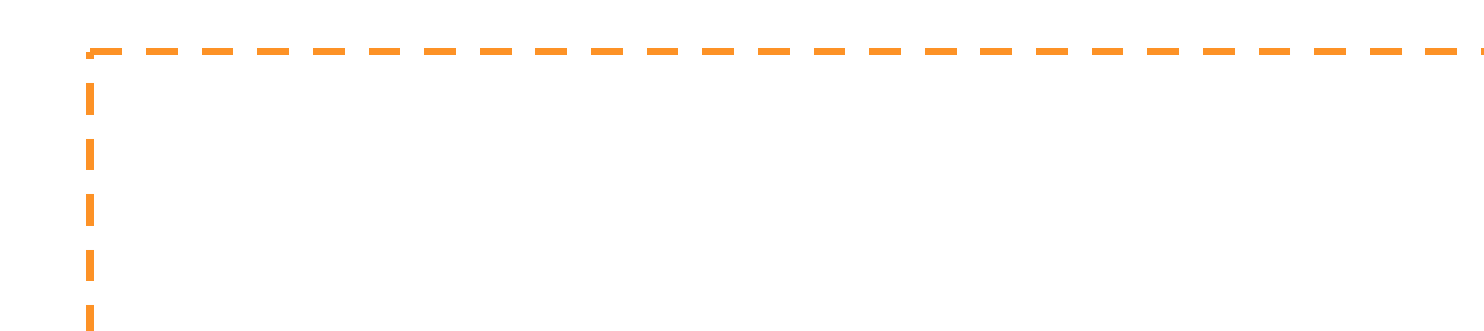
Google
YouTube
YouTube Client
YouTube Server
Internet
MONROE node
ASTREAM Client
Simula
Vodafone
Basic SARA BBA
ASTREAM Server

Slide 11

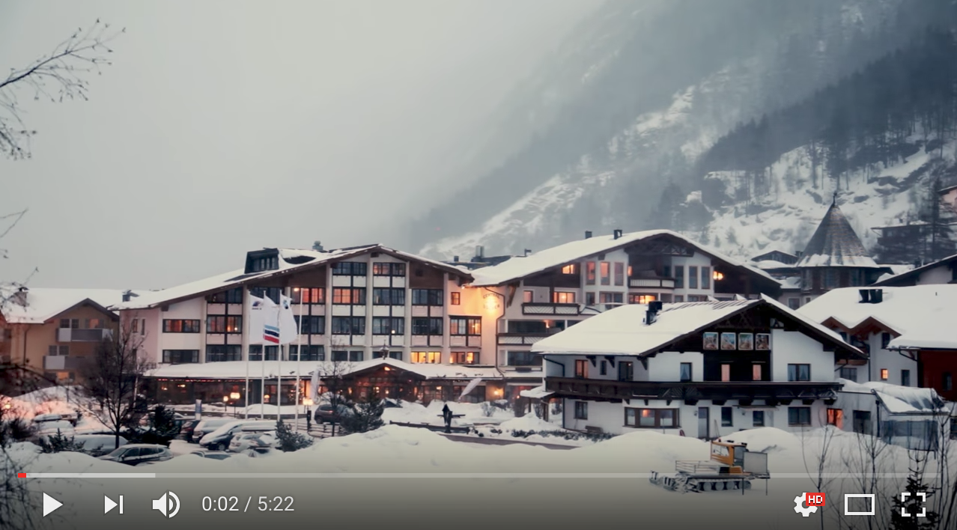

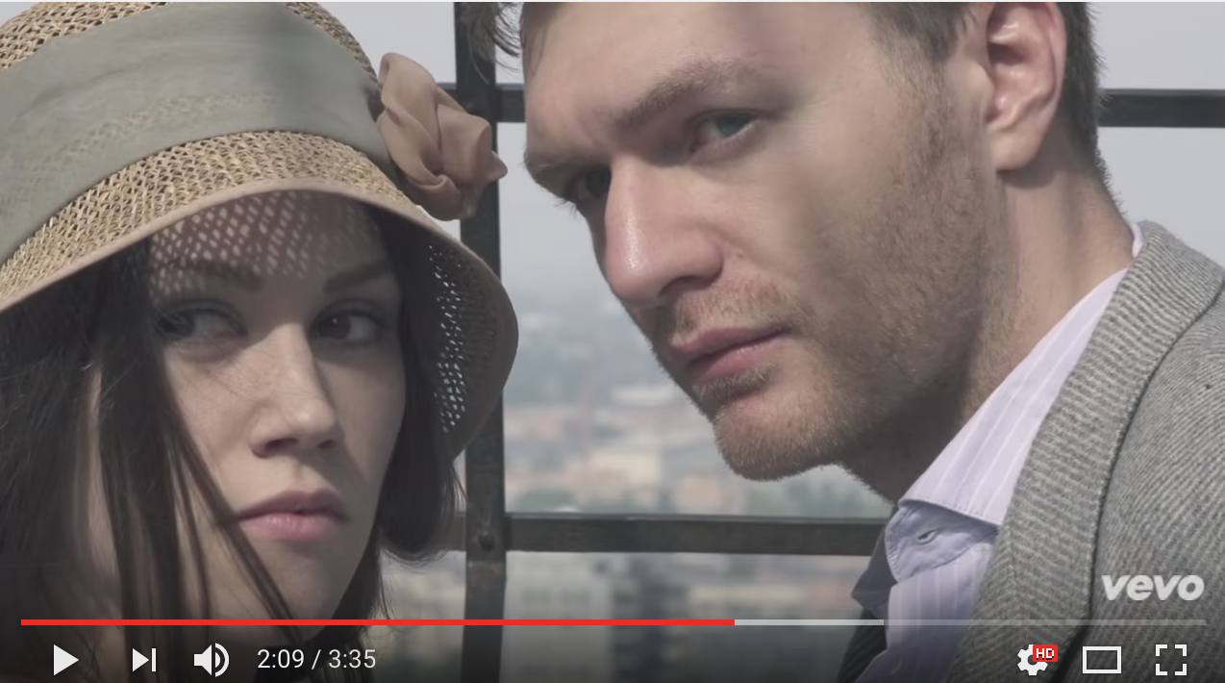



YouTube Server
YouTube
YouTube Client
Internet
MONROE Node
ASTREAM Client
Vodafone
Astream Server
Basic SARA BBA

Slide 12
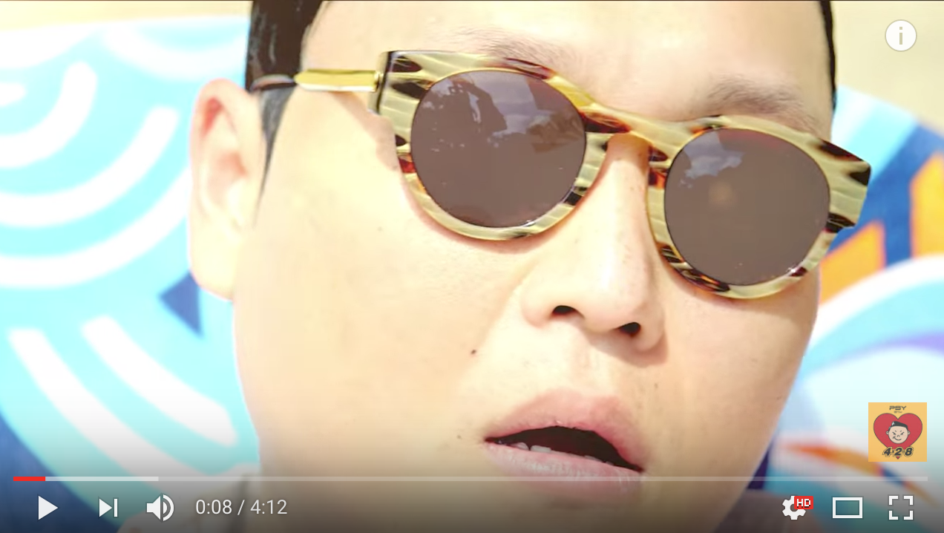
1. Download available representations
2. Generate MPD and segments
3. Load MPD and segments to server
4. Specify desired MPD in runtime (Docker config)
MONROE node

Slide 13
1. Download available representations
2. Generate MPD and segments
3. Load MPD and segments to server
4. Specify desired MPD in runtime (Docker config)
MONROE node

Slide 14
tools_{batch} = rand*{Speedtest, OpenSignal, Nettest, MobiPerf}
Batch 1
Batch 2
tools₁ (1)
tools₁ (2)
tools₁ (3)
tools₁ (4)
tools₂ (1)
tools₂ (2)
tools₂ (3)
tools₂ (4)
10s
10s
10s
10s
10s
10s
30
min

Slide 15
adaptation_{rx} = rand*{YouTube, Basic, SARA, Netflix}
Video 1
Video 2
adaptation_{r1}
adaptation_{r2}
adaptation_{r3}
adaptation_{r4}
adaptation_{r1}
adaptation_{r2}
adaptation_{r3}
adaptation_{r4}
10s
10s
10s
10s
10s
10s
30
min

Slide 16
Batch
Video 1
Video 2
Video 3
Video 4
Video 5
adaptation_{r2}
adaptation_{r4}
adaptation_{r2}
adaptation_{r4}
adaptation_{r4}
adaptation_{r4}
adaptation_{r4}
adaptation_{r1}
adaptation_{r3}
adaptation_{r3}
adaptation_{r2}
adaptation_{r3}
adaptation_{r2}
adaptation_{r3}
adaptation_{r2}
adaptation_{r1}
adaptation_{r1}
adaptation_{r1}
adaptation_{r1}
adaptation_{r3}
10s
10s
10s
10s
10s
10s
10s
10s
10s
10s
10s
10s
10s
10s
10s
30
min
30
min
30
min
30
min
adaptation_{rx} = rand*{YouTube, Basic, SARA, Netflix}

Slide 17
Joint Framework
Measurements in MONROE
Data Analysis

Slide 18
Joint Framework
Measurements in MONROE
Data Analysis

Slide 19
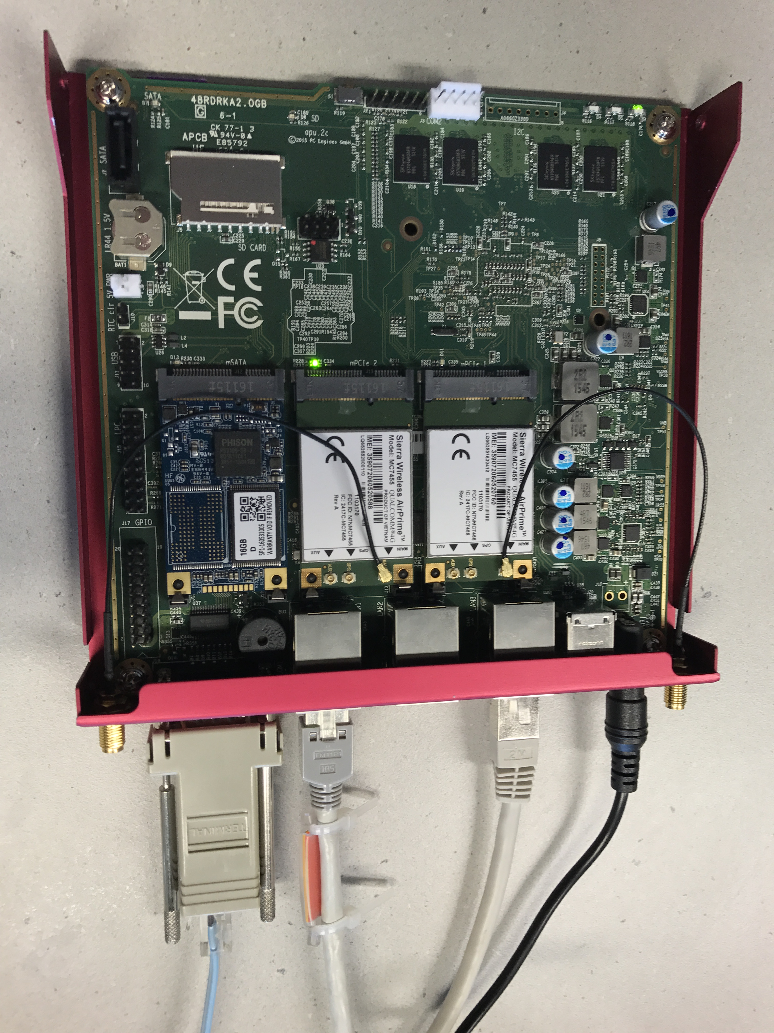
ETH2
2 x SIM
ETH1
SERIAL

Slide 20
Video QoE
Rate adaptation
Video content
Network operator
Technology
Time
Location
Mobility

Slide 21
Video QoE
Rate adaptation
Video content
Network operator
Technology
Location
Time
Device
Mobility

